Slide 1
Visible / Shortwave Infrared Imaging Spectroscopy at JPL: Instruments and Algorithms
David R. Thompson, Robert O. Green, Michael Eastwood, and the AVIRIS team
Jet Propulsion Laboratory, California Institute of Technology
Copyright 2017 California Institute of Technology. All rights reserved.
US Government Support Acknowledged.

Slide 2
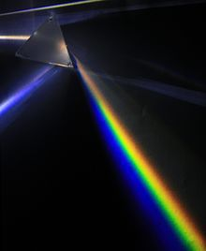
A Typical Radiance Spectrum
Typical units are W m⁻² sr⁻¹ nm⁻¹

Slide 3
Imaging spectroscopy – 100s of parallel spectrometers
Detector Array
Spectrometer
Slit
Telescope

Slide 4
Imaging spectroscopy – 100s of parallel spectrometers
Detector Array
Spectrometer
Slit
Telescope

Slide 5
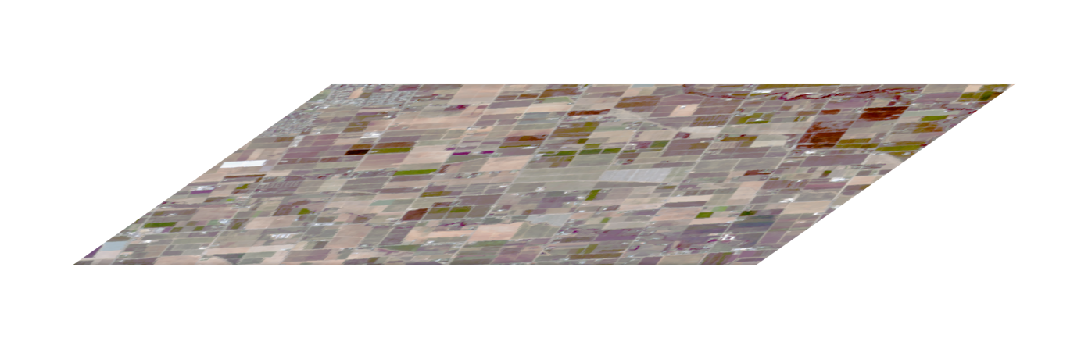
Imaging spectroscopy – 100s of parallel spectrometers
Detector Array
Spectrometer
Slit
Telescope

Slide 6
Imaging spectroscopy – 100s of parallel spectrometers
Detector Array
Spectrometer
Slit
Telescope

Slide 7
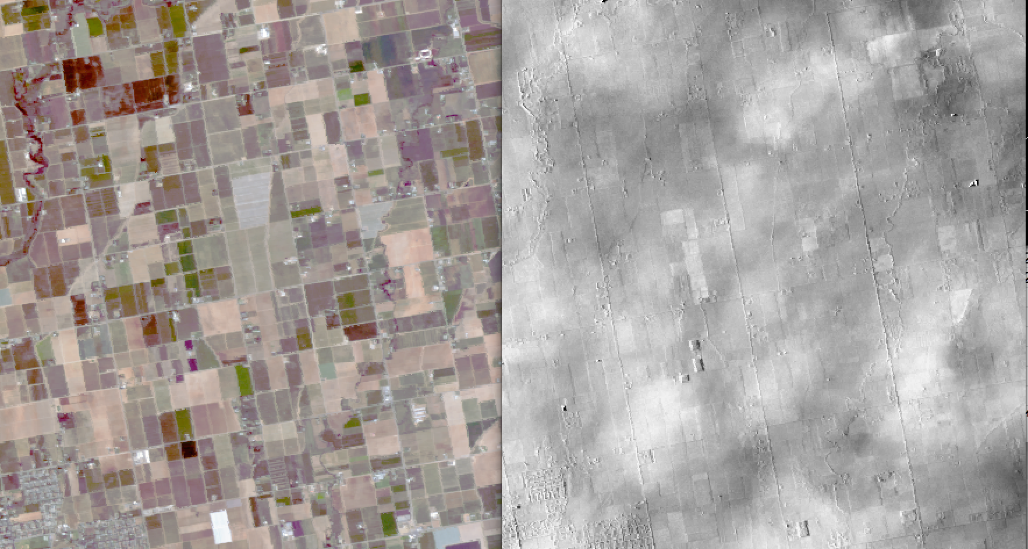
Imaging spectroscopy – 100s of parallel spectrometers
Radiance cube
H₂O vapor abundance

Slide 8
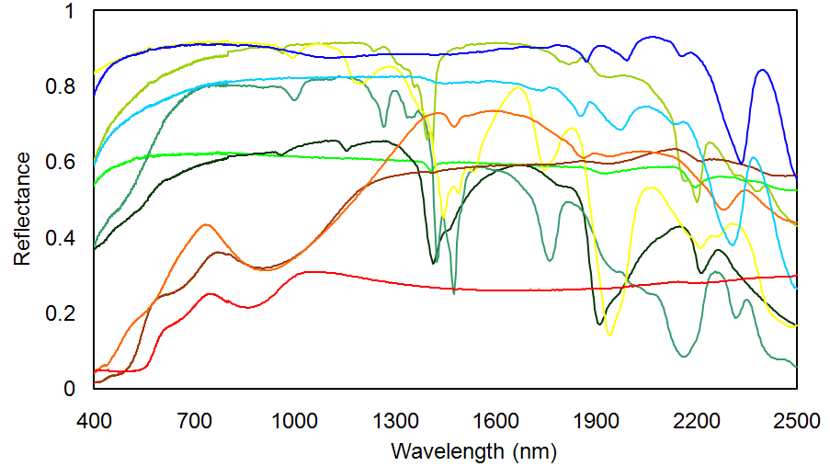
Reflectance enables quantitative measurement of surface properties
Calcite
Muscovite
Hematite

Slide 9
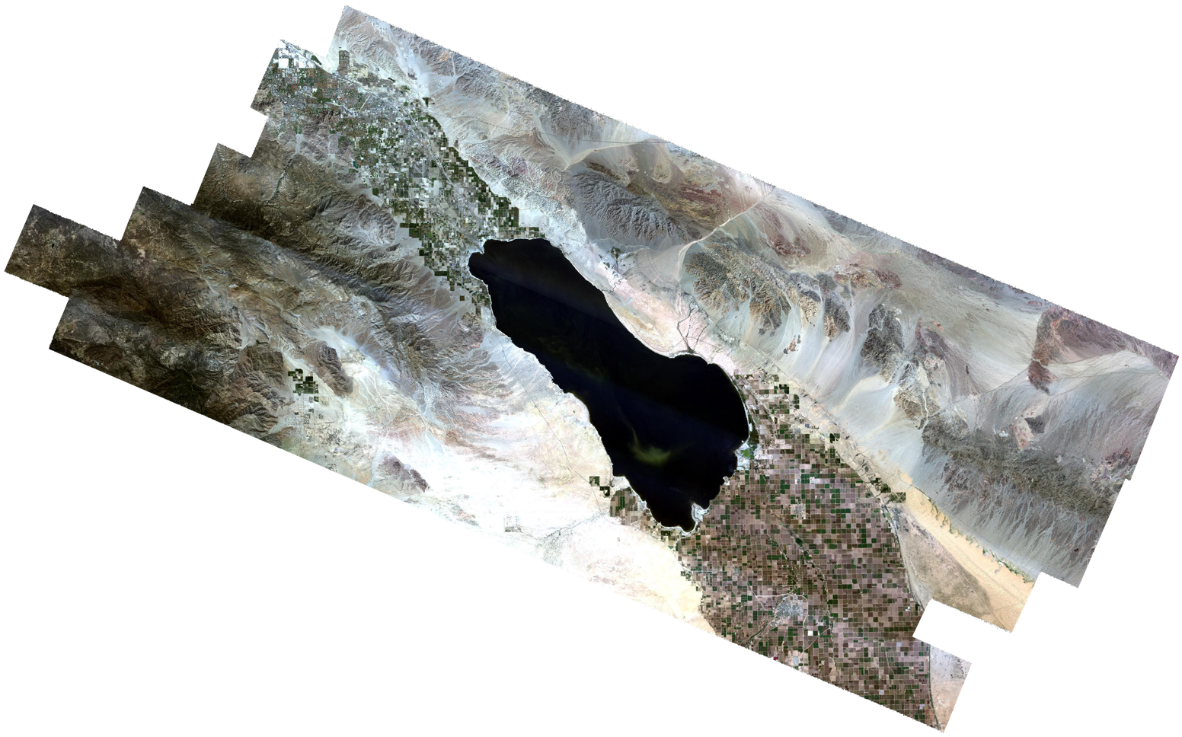
Continuum-interpolated absorption fits
Mineral absorption
Surface Reflectance
(Salton Sea, CA)

Slide 10
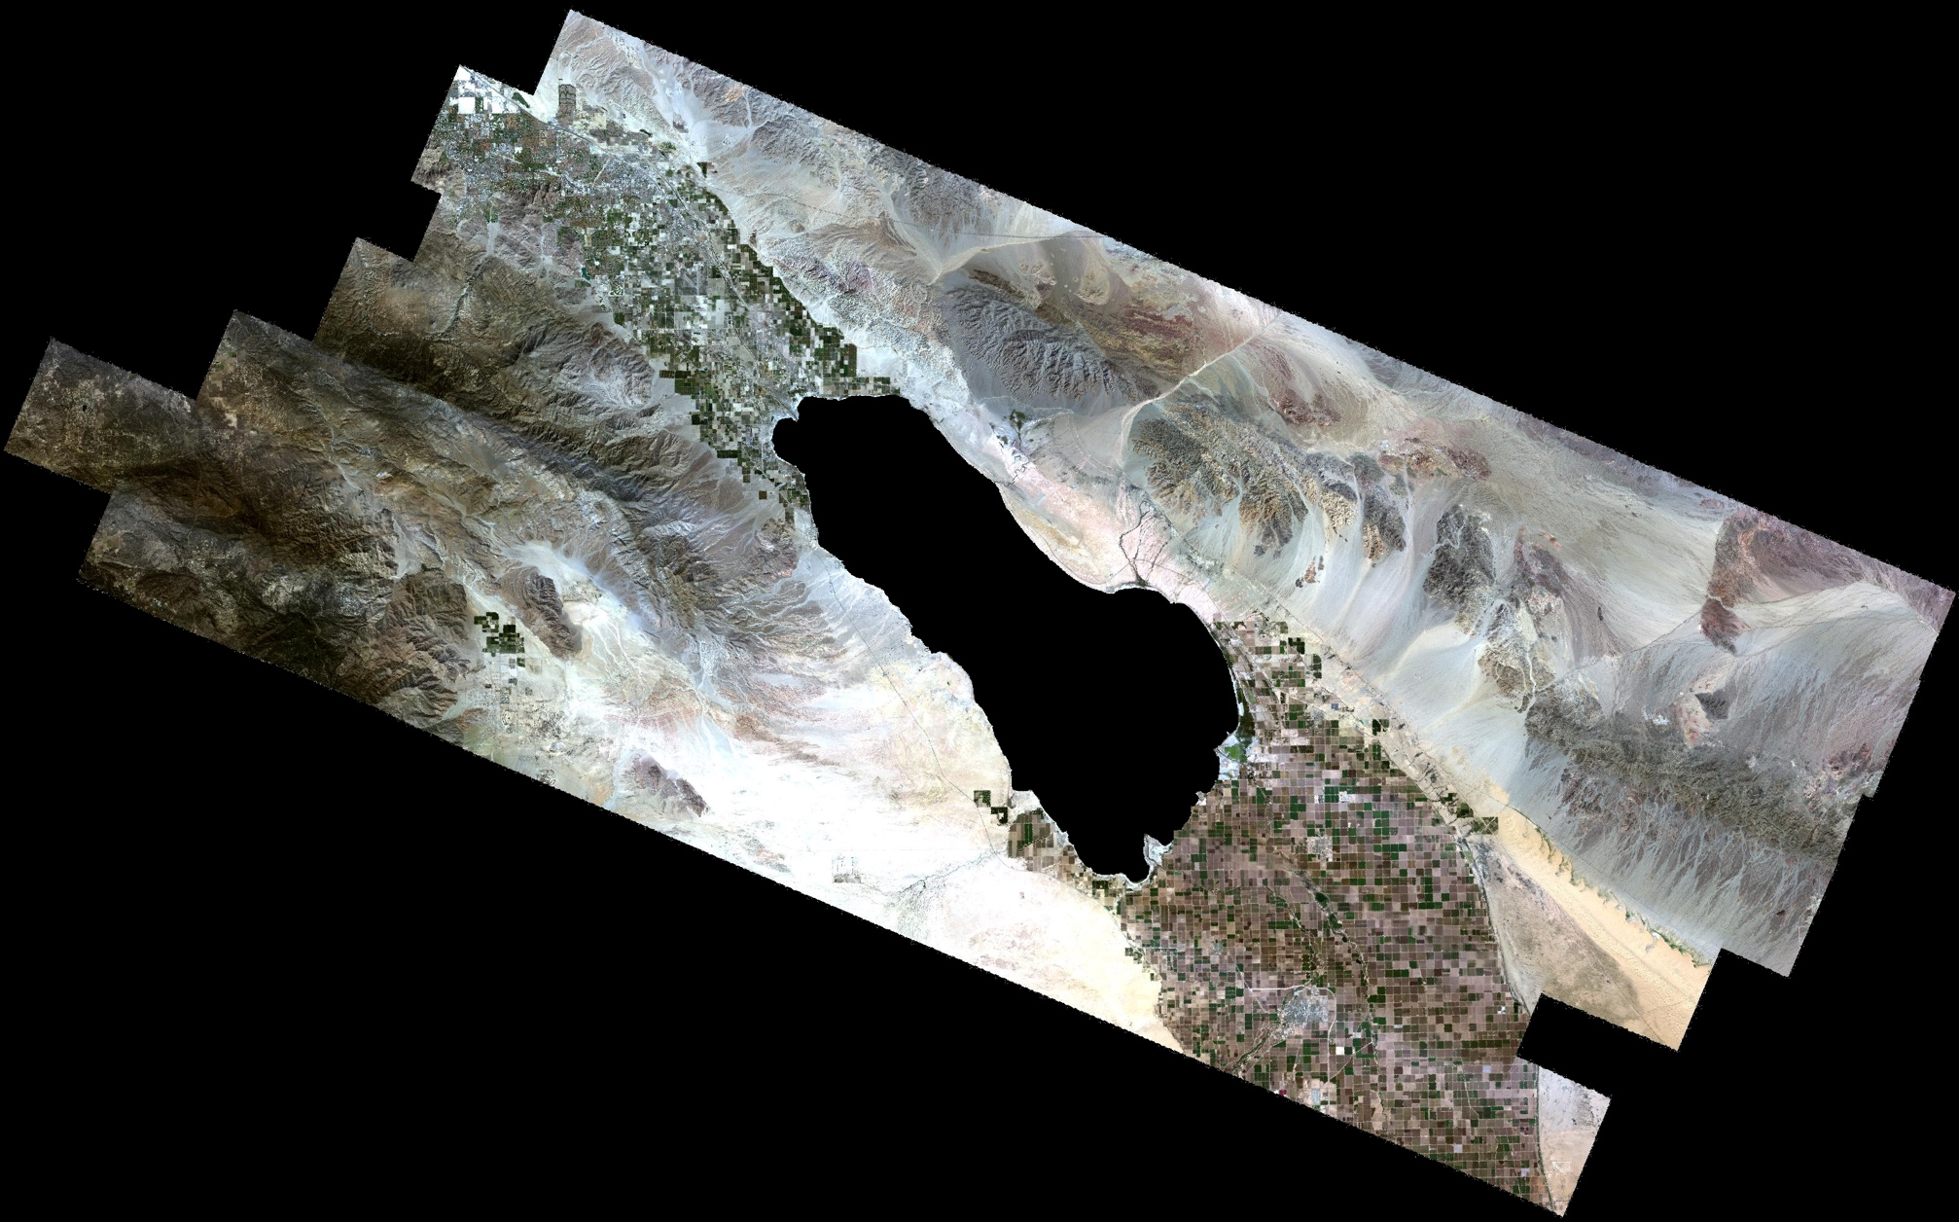
Salton Sea, CA (AVIRIS instrument)
Courtesy NASA/JPL/Roger Clark

Slide 11
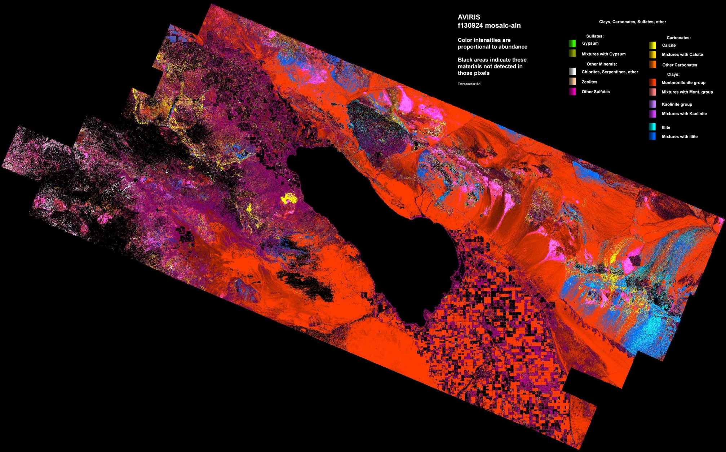
Salton Sea, CA (AVIRIS instrument)
Courtesy NASA / JPL / USGS / R. Clark
Salton Sea
Mineral Map
50km
Courtesy NASA/JPL/Roger Clark

Slide 12
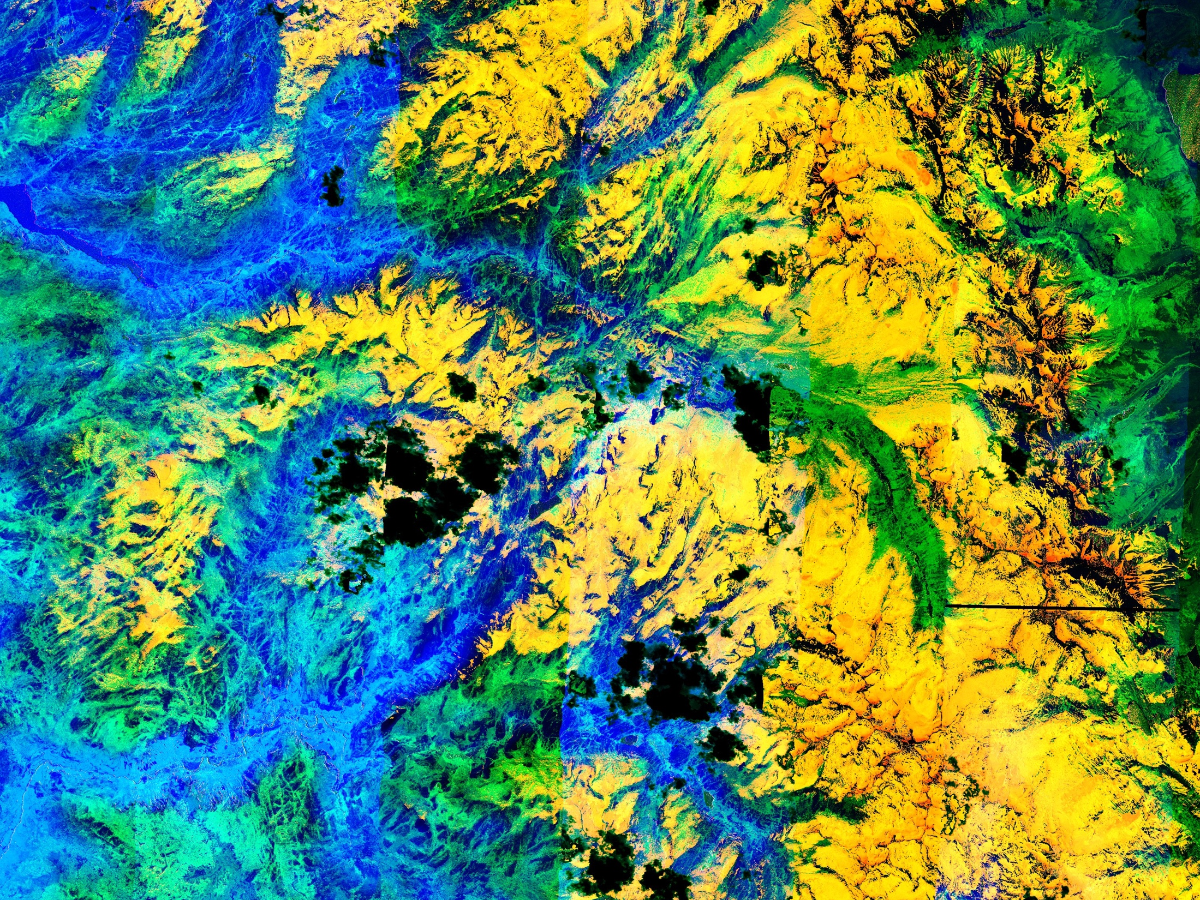
Yosemite Mosaic f130503 (no color blending applied) Vapor Liquid Ice Melting
Clouds
Half dome
[Thompson et al., RSE 2015

Slide 13
Vegetation absorption features

Slide 14
Earth Science Applications
Map terrestrial ecosystem composition and health
Characterize and map aquatic ecosystems such as coral reefs, phytoplankton
Geologic maps
Find and quantify greenhouse point sources
Urban studies
Agriculture
Cryosphere, water quality and resource studies

Slide 15
Information Science Collaborations
Next-generation remote sensing algorithms bridging physically-based models with learned components
Bayesian statistical treatments for rigorous end-to-end uncertainty propagation
Synergy with radar and other sensing modalities
Scaling to the future HyspIRI mission

